Slide 1
Cyclistic: Member vs Non-member
By: Nand Mehta
Data taken from Aug - Nov 2024

Slide 2
Table Of Contents
What are we talking about?
The Data
Conclusion

Slide 3
Objective

Slide 4
Objective
Cyclistic is a bike share company in Chicago that has annual members and casual users
How do annual members and casual users use Cyclistic differently and how can we convert casual users into annual members?

Slide 5
The Data

Slide 6
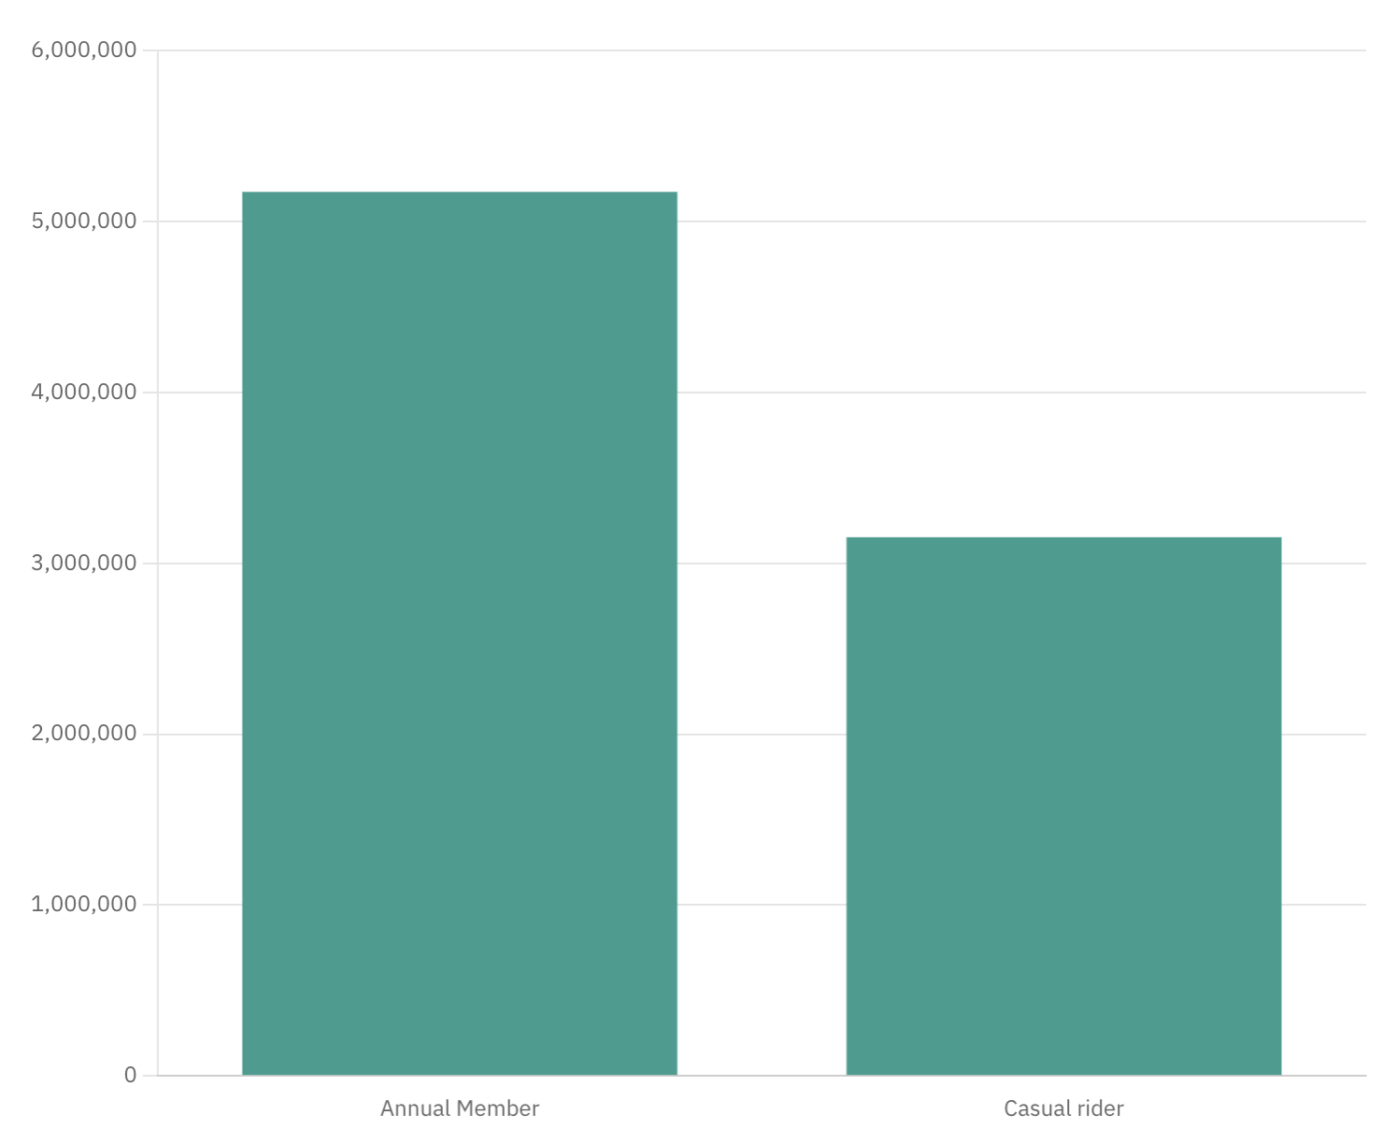
Rides by Membership Type Aug - Nov
Annual Members - 5,174,296
Casual Riders - 3,153,014

Slide 7
Rides by Membership Type Aug - Sept
Annual Members - 2,559,232
Casual Riders - 1,862,545
Rides by Membership Type Oct - Nov
Annual Members - 2,615,064
Casual Riders - 1,290,469

Slide 8
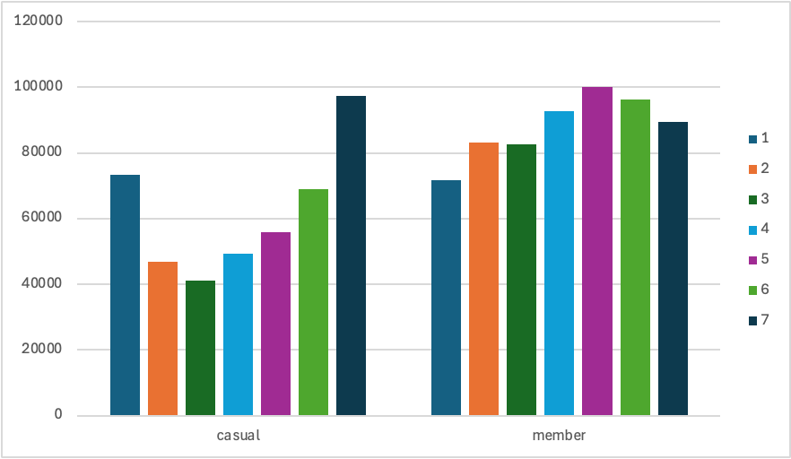
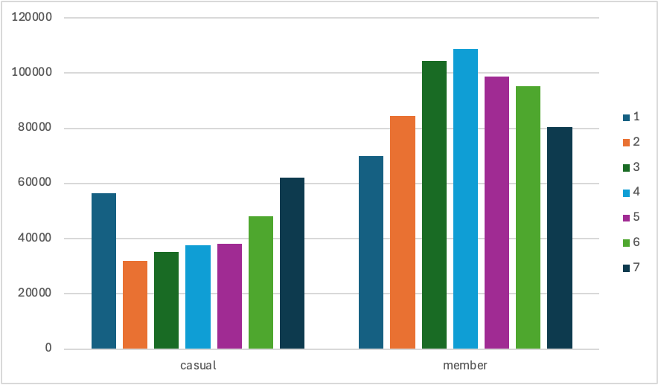
Average Daily Rides by Membership Type
Aug - Sept
Oct - Nov
For casual members we can see an influx in activity on days 1 and 7 which correlates with Saturday and Sunday and the opposite for annual members
We can also see a dip in activity for casual riders during the months of October-November when the weather starts to get colder

Slide 9
Aug - Sept
Oct - Nov
Casual riders tend to use Cyclistic more on weekends
Annual members use Cyclistic more on weekdays

Slide 10
Conclusions

Slide 11
Conclusion
Casual riders tend to use Cyclistic more on weekends than weekdays and the opposite for annual members
Evidence suggests that Casual riders use the program more for their own pleasure/leisure
Where as, Annual members are using the bikes as a mode of reliable transportation, likely to work or school
As the year approaches the colder months, there is a significant decrease in casual riders where as annual members continued to stay around the same area

